Slide 1
Species distributions and 2D spatial models

Slide 2
Why might we care about 2D spatial models?
Experimental plots
Often uses grid
Observational analysis
Fish surveys

Slide 3
2D spatial models
Species distribution models
Widely used tool in zoology, conservation-planning, and invasion biology
Synonyms:
Climate envelop model – Fit model to species observations, and then identify other areas with suitable conditions
Species density model – Sometimes used when fitting to density rather than presence/absence data
Often used to infer “Grinnellian niche”
Assumes distribution is a product of habitat variables that are measurable and whose action is local

Slide 4
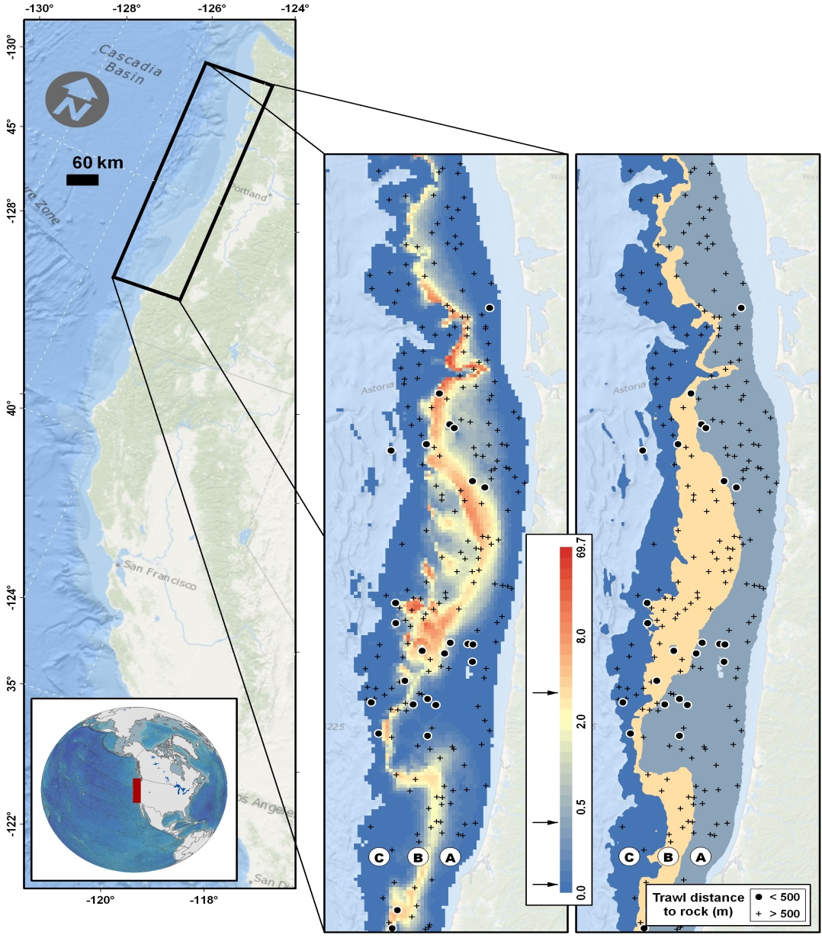
2D spatial models
Spatial models are useful for estimating species distribution
Capture fine-scale variation
Decrease residual variation -> Decrease standard errors
Shelton Thorson Ward Feist (2014) CJFAS

Slide 5
2D spatial models
Two potential treatments
Equally spaced grid
Unequal or sporadic spacing

Slide 6
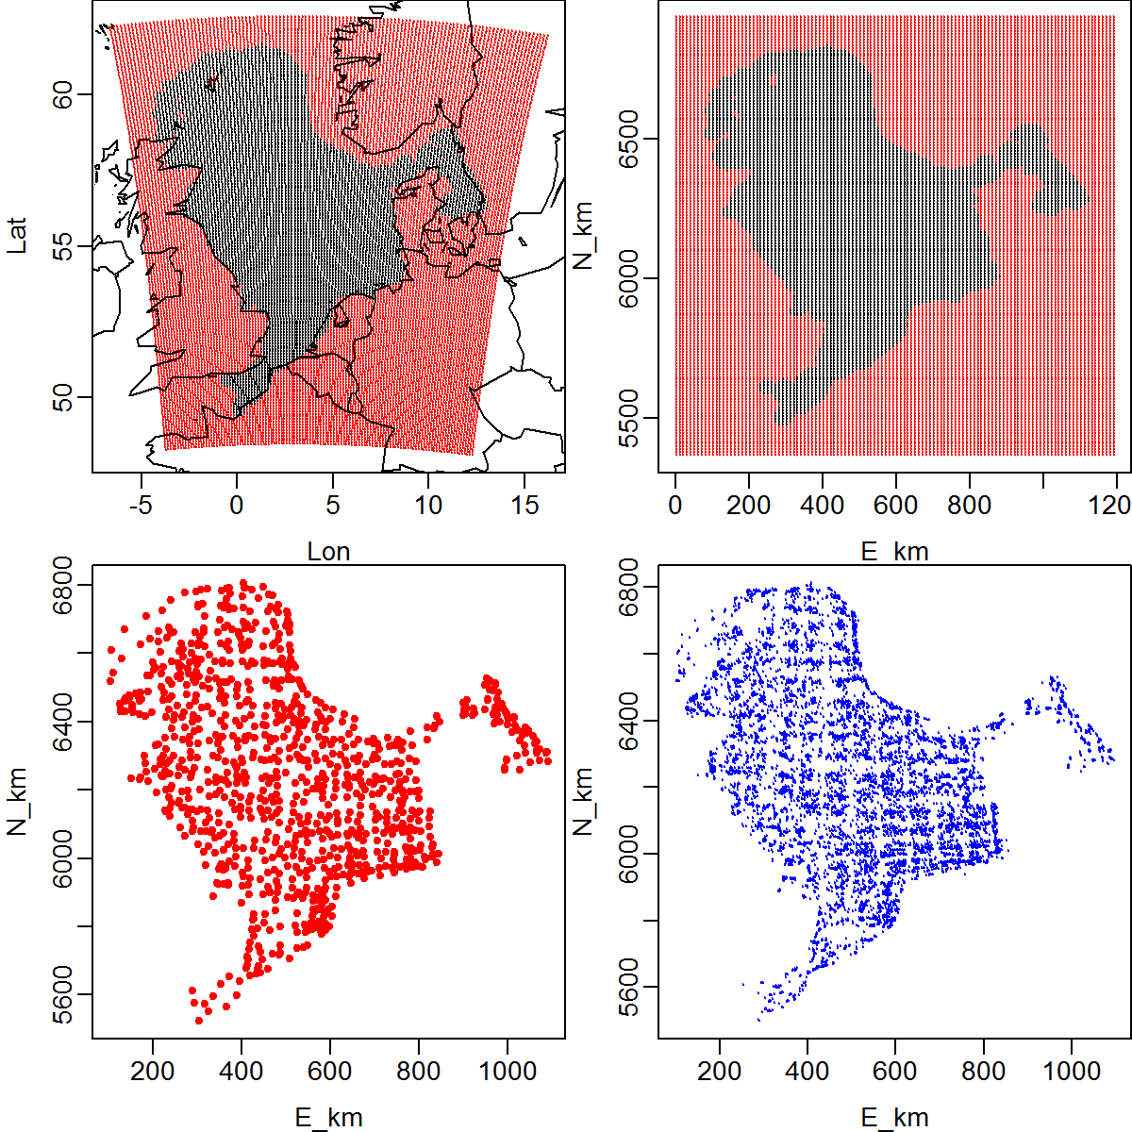
2D spatial models
Two potential treatments
Equally spaced grid
Example #1: Divide north sea into grid
Domain of samples
(black: Included)
Location of samples

Slide 7
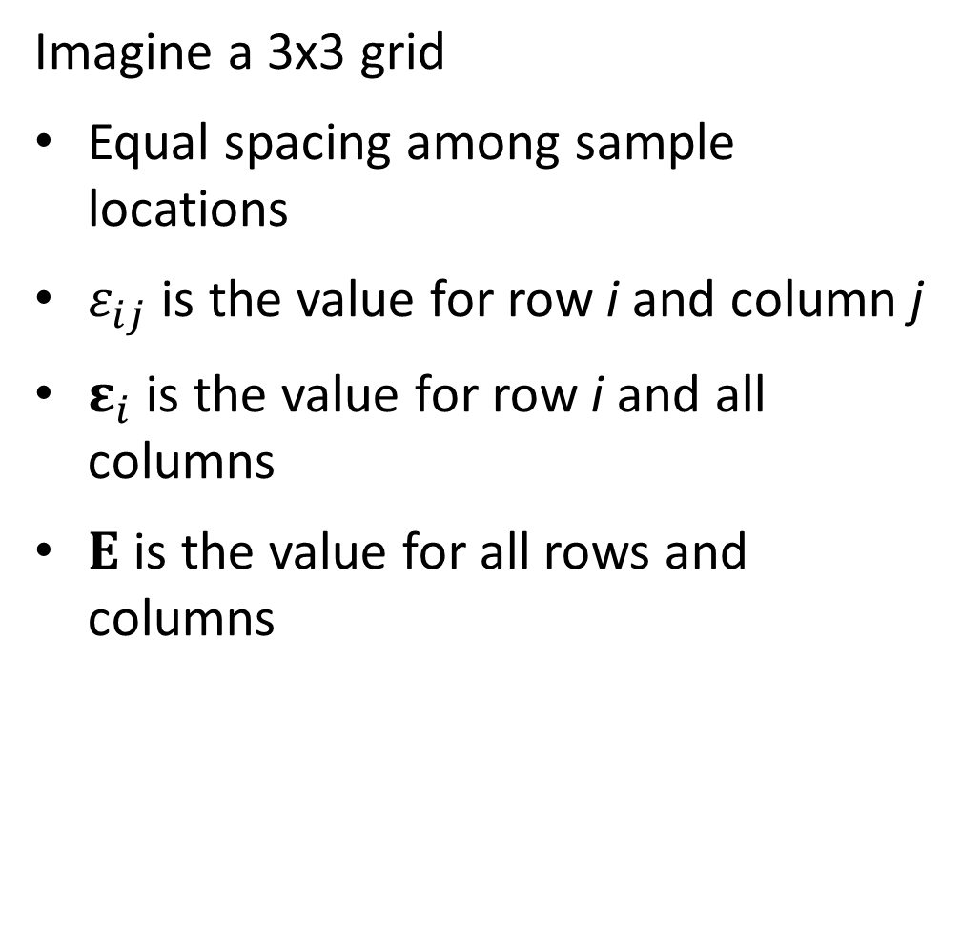
2D spatial models
Imagine a 3x3 grid
Equal spacing among sample locations
$ε_{ij}$ is the value for row i and column j
$ε_{i}$ is the value for row i and all columns
$Ε$ is the value for all rows and columns

Slide 8
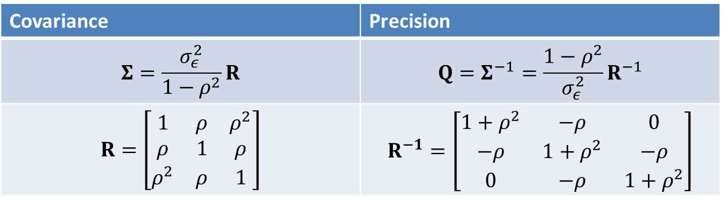
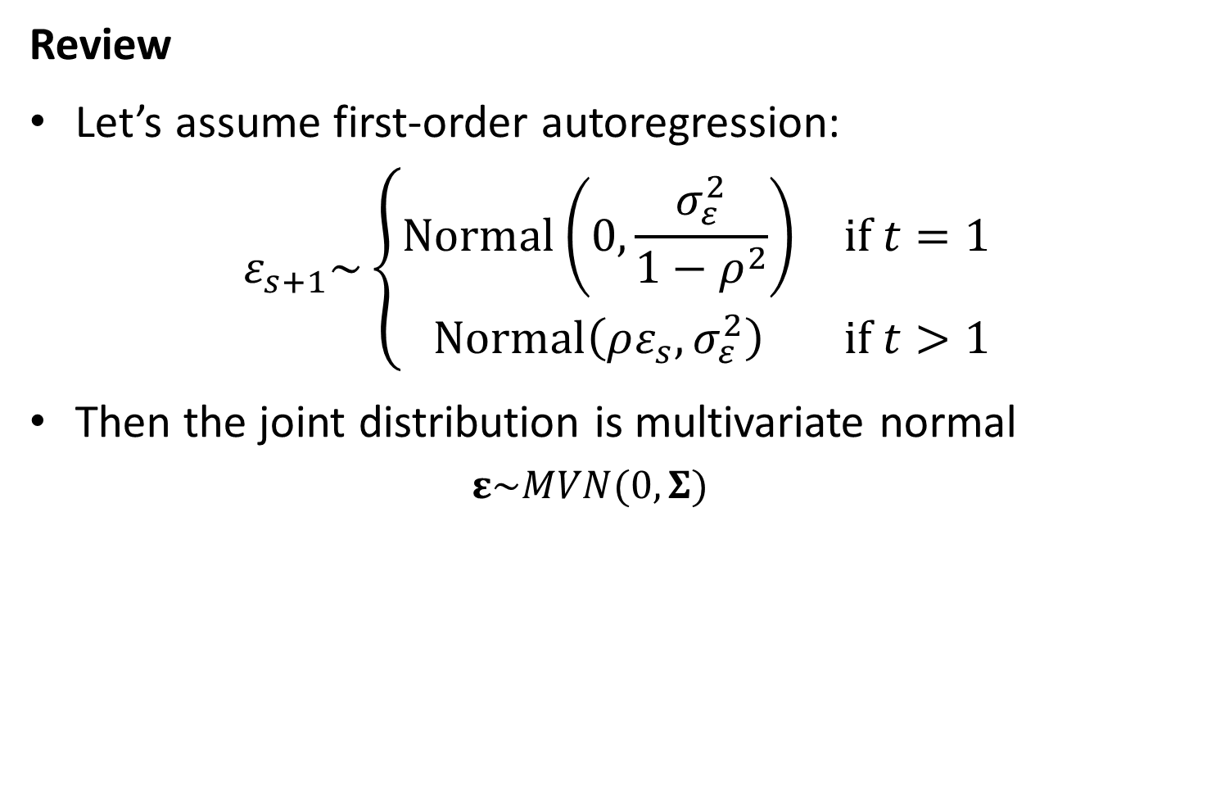
2D spatial models
Review
Let’s assume first-order autoregression:
$$ε_{s+1}\sim \left\{\begin{matrix}Normal\left(0,\frac{σ_{ε}^{2}}{1−ρ^{2}}\right) & if t=1 \\ Normal\left(ρε_{s},σ_{ε}^{2}\right) & if t>1\end{matrix}\right.$$
Then the joint distribution is multivariate normal
$$ε\sim MVN(0,Σ)$$
Covariance | Precision
$$Σ=\frac{σ_{ε}^{2}}{1−ρ^{2}}R$$ | $$Q=Σ^{−1}=\frac{1−ρ^{2}}{σ_{ε}^{2}}R^{−1}$$
$$R=\left[\begin{matrix}1 & ρ & ρ^{2} \\ ρ & 1 & ρ \\ ρ^{2} & ρ & 1\end{matrix}\right]$$ | $$R^{−1}=\left[\begin{matrix}1+ρ^{2} & −ρ & 0 \\ −ρ & 1+ρ^{2} & −ρ \\ 0 & −ρ & 1+ρ^{2}\end{matrix}\right]$$

Slide 9
2D spatial models
Intuitive to extend this
What is the distribution for Row #2 conditional on Row #1
[Work through on board]
Row #
1
2
3

Slide 10
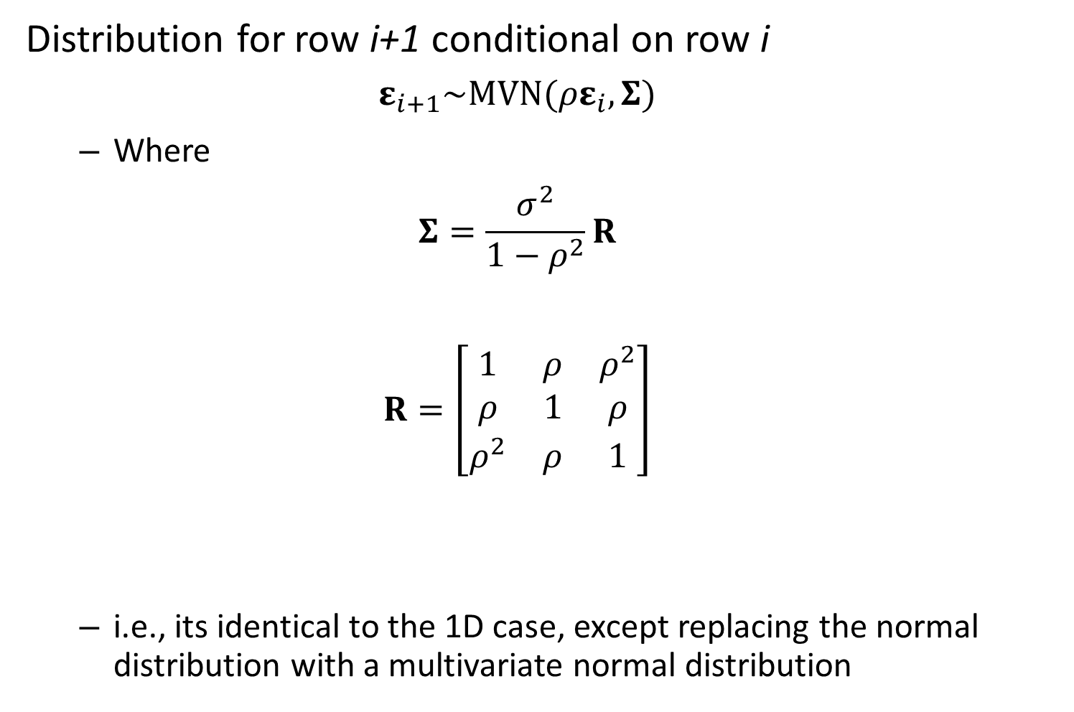
2D spatial models
Distribution for row i+1 conditional on row i
$$ε_{i+1}\sim MVN(ρε_{i},Σ)$$
Where
$$Σ=\frac{σ^{2}}{1−ρ^{2}}R$$
$$R=\left[\begin{matrix}1 & ρ & ρ^{2} \\ ρ & 1 & ρ \\ ρ^{2} & ρ & 1\end{matrix}\right]$$
i.e., its identical to the 1D case, except replacing the normal distribution with a multivariate normal distribution

Slide 11
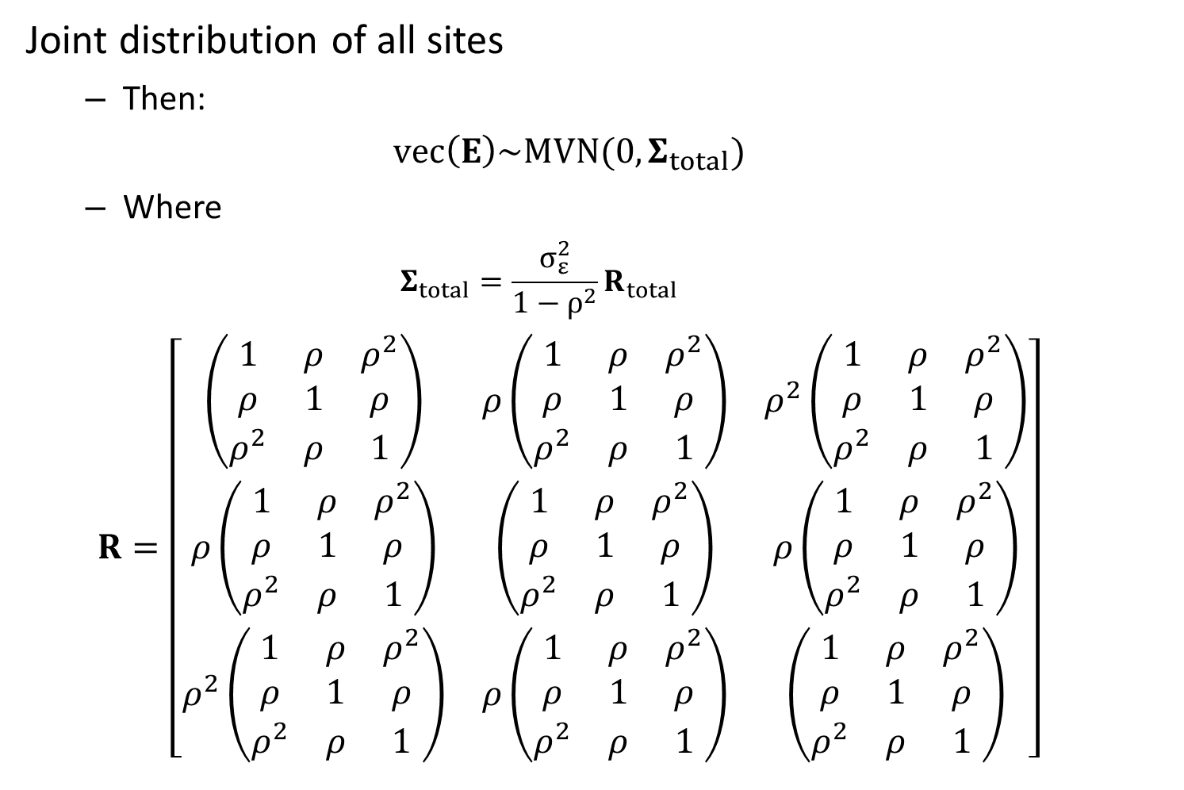
2D spatial models
Joint distribution of all sites
Then:
$$vec\left(Ε\right)\sim MVN(0,Σ_{total})$$
Where
$$Σ_{total}=\frac{σ_{ε}^{2}}{1−ρ^{2}}R_{total}$$
$$R=\left[\begin{matrix}\left(\begin{matrix}1 & ρ & ρ^{2} \\ ρ & 1 & ρ \\ ρ^{2} & ρ & 1\end{matrix}\right) & ρ\left(\begin{matrix}1 & ρ & ρ^{2} \\ ρ & 1 & ρ \\ ρ^{2} & ρ & 1\end{matrix}\right) & ρ^{2}\left(\begin{matrix}1 & ρ & ρ^{2} \\ ρ & 1 & ρ \\ ρ^{2} & ρ & 1\end{matrix}\right) \\ ρ\left(\begin{matrix}1 & ρ & ρ^{2} \\ ρ & 1 & ρ \\ ρ^{2} & ρ & 1\end{matrix}\right) & \left(\begin{matrix}1 & ρ & ρ^{2} \\ ρ & 1 & ρ \\ ρ^{2} & ρ & 1\end{matrix}\right) & ρ\left(\begin{matrix}1 & ρ & ρ^{2} \\ ρ & 1 & ρ \\ ρ^{2} & ρ & 1\end{matrix}\right) \\ ρ^{2}\left(\begin{matrix}1 & ρ & ρ^{2} \\ ρ & 1 & ρ \\ ρ^{2} & ρ & 1\end{matrix}\right) & ρ\left(\begin{matrix}1 & ρ & ρ^{2} \\ ρ & 1 & ρ \\ ρ^{2} & ρ & 1\end{matrix}\right) & \left(\begin{matrix}1 & ρ & ρ^{2} \\ ρ & 1 & ρ \\ ρ^{2} & ρ & 1\end{matrix}\right)\end{matrix}\right]$$

Slide 12
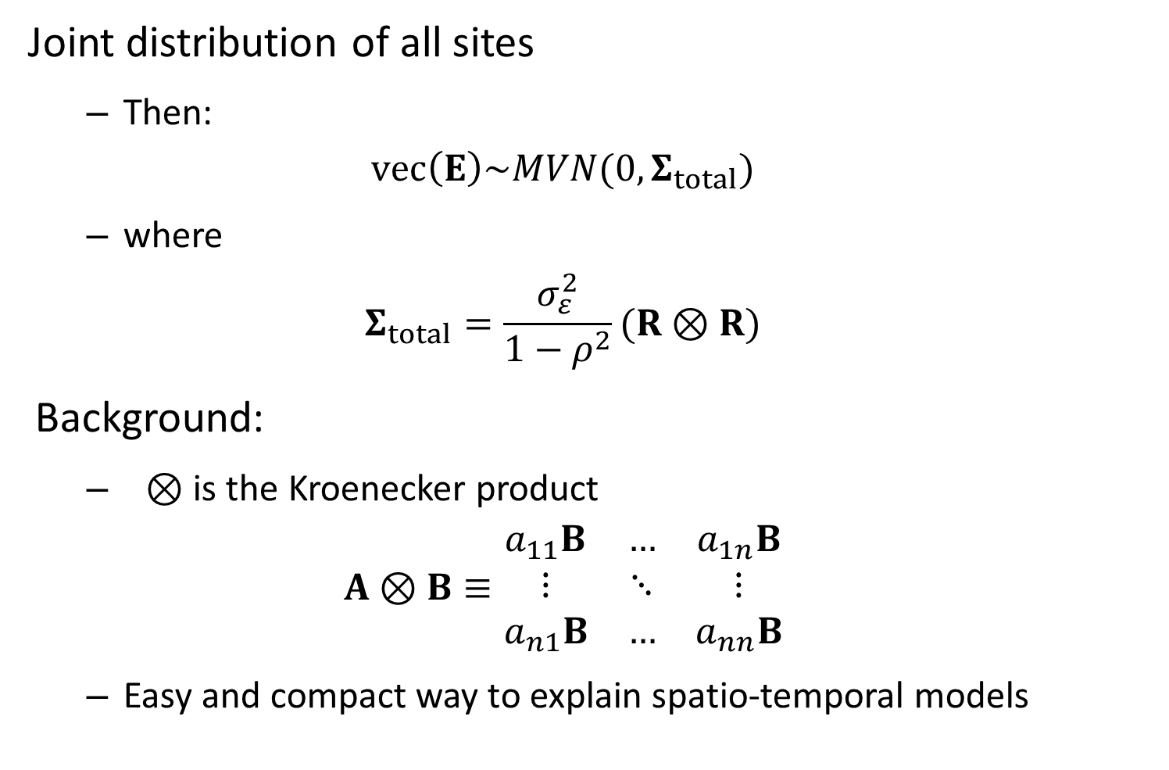
2D spatial models
Joint distribution of all sites
Then:
$$vec\left(Ε\right)\sim MVN(0,Σ_{total})$$
where
$$Σ_{total}=\frac{σ_{ε}^{2}}{1−ρ^{2}}(R⊗R)$$
Background:
$⊗$ is the Kroenecker product
$$A⊗B≡\begin{matrix}a_{11}B & … & a_{1n}B \\ ⋮ & ⋱ & ⋮ \\ a_{n1}B & … & a_{nn}B\end{matrix}$$
Easy and compact way to explain spatio-temporal models

Slide 13

2D spatial models
Kroenecker product inverse is easy
$$Σ_{total}=σ_{ε}^{2}\left(R⊗R\right)=\frac{1}{σ_{ε}^{2}}\left(Q^{−1}⊗Q^{−1}\right)=\frac{1}{σ_{ε}^{2}}Q_{total}^{−1}$$
where we know how to calculate $Q^{−1}$
$$Q=\left[\begin{matrix}1+ρ^{2} & −ρ & 0 \\ −ρ & 1+ρ^{2} & −ρ \\ 0 & −ρ & 1+ρ^{2}\end{matrix}\right]$$
Such that:
$$Q_{total} =\left[\begin{matrix}(1+ρ^{2})\left(\begin{matrix}1+ρ^{2} & −ρ & 0 \\ −ρ & 1+ρ^{2} & −ρ \\ 0 & −ρ & 1+ρ^{2}\end{matrix}\right) & −ρ\left(\begin{matrix}1+ρ^{2} & −ρ & 0 \\ −ρ & 1+ρ^{2} & −ρ \\ 0 & −ρ & 1+ρ^{2}\end{matrix}\right) & 0\left(\begin{matrix}1+ρ^{2} & −ρ & 0 \\ −ρ & 1+ρ^{2} & −ρ \\ 0 & −ρ & 1+ρ^{2}\end{matrix}\right) \\ −ρ\left(\begin{matrix}1+ρ^{2} & −ρ & 0 \\ −ρ & 1+ρ^{2} & −ρ \\ 0 & −ρ & 1+ρ^{2}\end{matrix}\right) & (1+ρ^{2})\left(\begin{matrix}1+ρ^{2} & −ρ & 0 \\ −ρ & 1+ρ^{2} & −ρ \\ 0 & −ρ & 1+ρ^{2}\end{matrix}\right) & −ρ\left(\begin{matrix}1+ρ^{2} & −ρ & 0 \\ −ρ & 1+ρ^{2} & −ρ \\ 0 & −ρ & 1+ρ^{2}\end{matrix}\right) \\ 0\left(\begin{matrix}1+ρ^{2} & −ρ & 0 \\ −ρ & 1+ρ^{2} & −ρ \\ 0 & −ρ & 1+ρ^{2}\end{matrix}\right) & −ρ\left(\begin{matrix}1+ρ^{2} & −ρ & 0 \\ −ρ & 1+ρ^{2} & −ρ \\ 0 & −ρ & 1+ρ^{2}\end{matrix}\right) & (1+ρ^{2})\left(\begin{matrix}1+ρ^{2} & −ρ & 0 \\ −ρ & 1+ρ^{2} & −ρ \\ 0 & −ρ & 1+ρ^{2}\end{matrix}\right)\end{matrix}\right]$$

Slide 14

2D spatial models
Kroenecker product conserves “sparseness”
If $A$ …
is $n_{A}$ by $n_{A}$
It has $n_{A}^{2}$ elements
But has $m_{A}<n_{A}^{2}$ non-zero elements
It has “sparseness” = $m_{A}/n_{A}^{2}$
If $B$ …
has $m_{B}<n_{B}^{2}$ non-zero elements
Then $A ⨂{B}$…
Has “sparseness” $({m_{B}m}_{A})/{\left(n_{A}n_{B}\right)}^{2}$

Slide 15
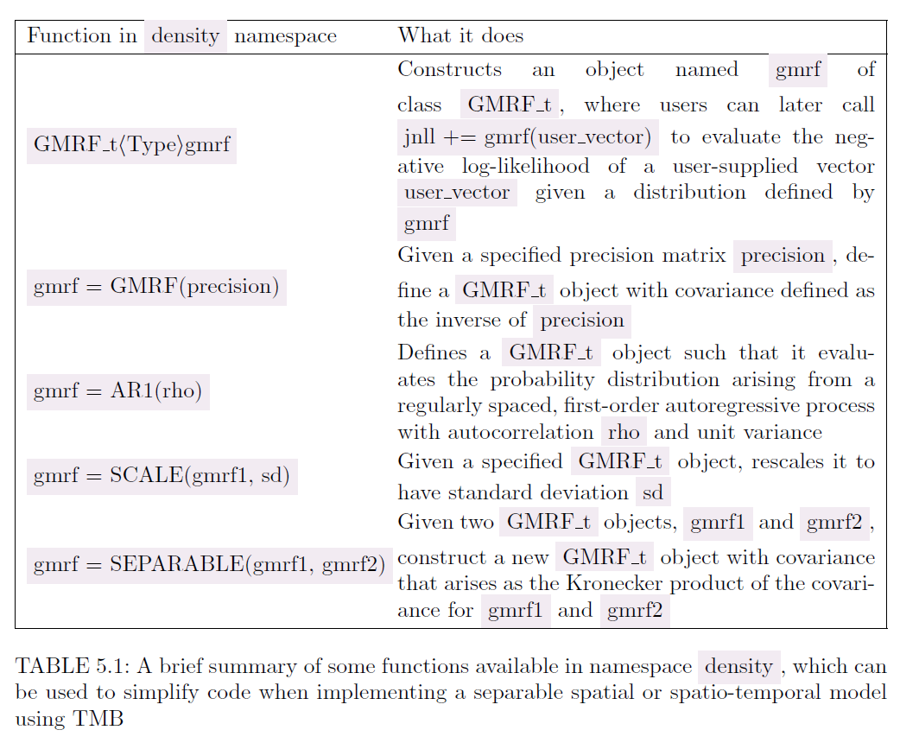

Slide 16
Two potential treatments
Equally spaced grid
Unequal spacing
SPDE method
“Stochastic partial differential equation” approximation
Lindgren, Rue, and Lindström. J. R. Stat. Soc. Ser. B Stat. Methodol. 73, 423–498 (2011).
Uses a Matern covariance function
We’ve been using an exponential covariance function
Derived using “finite element analysis”
Divides area into triangles

Slide 17
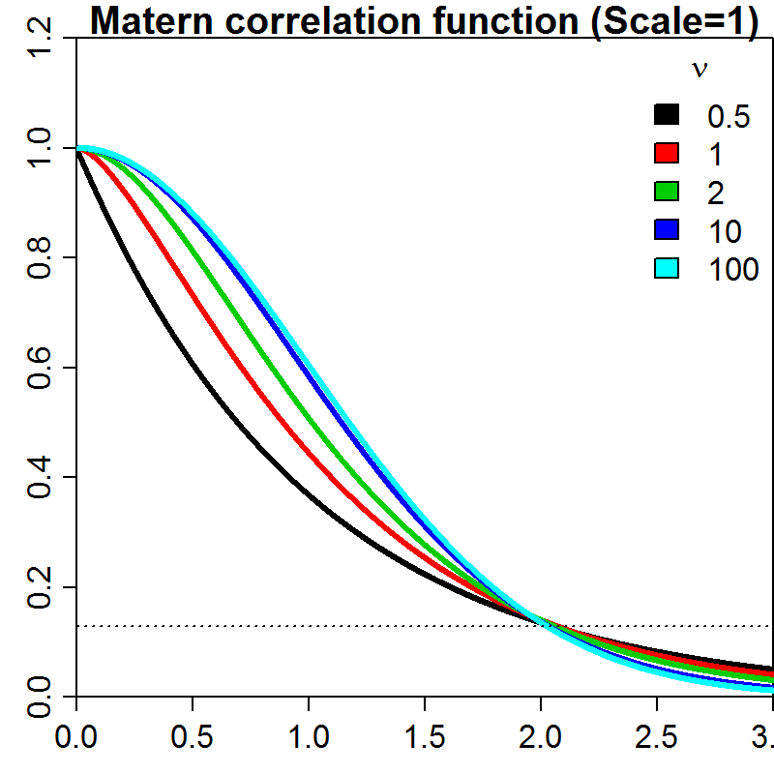
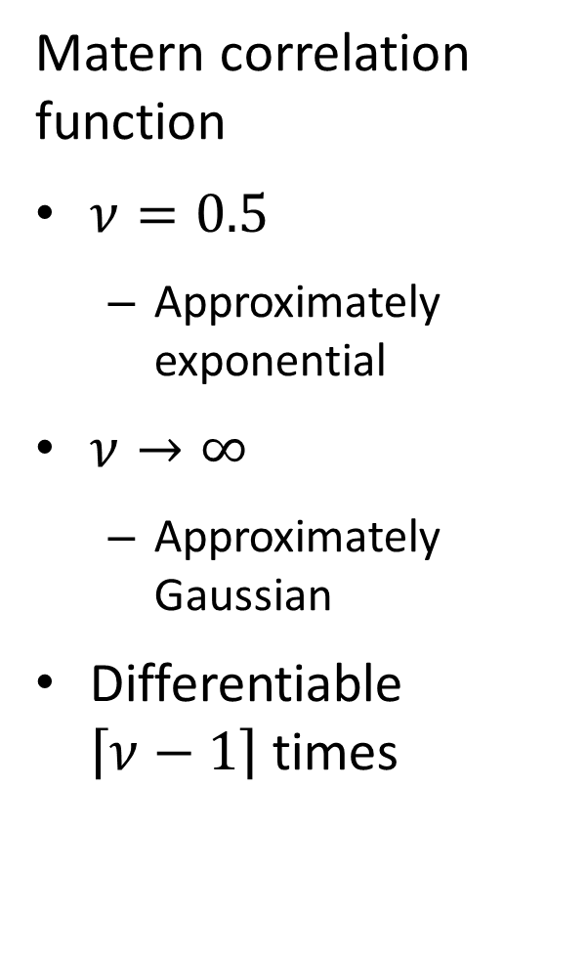
Matern correlation function
$ν=0.5$
Approximately exponential
$ν→∞$
Approximately Gaussian
Differentiable $\left\lceil ν−1\right\rceil$ times

Slide 18
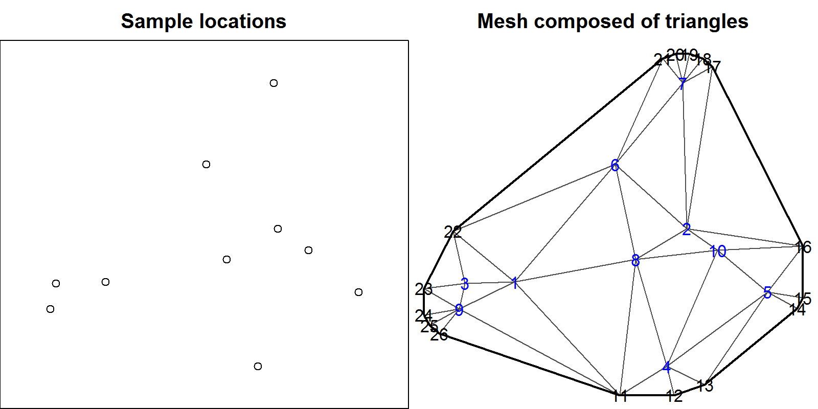
Two potential treatments
Equally spaced grid
Unequal or sporadic spacing

Slide 19
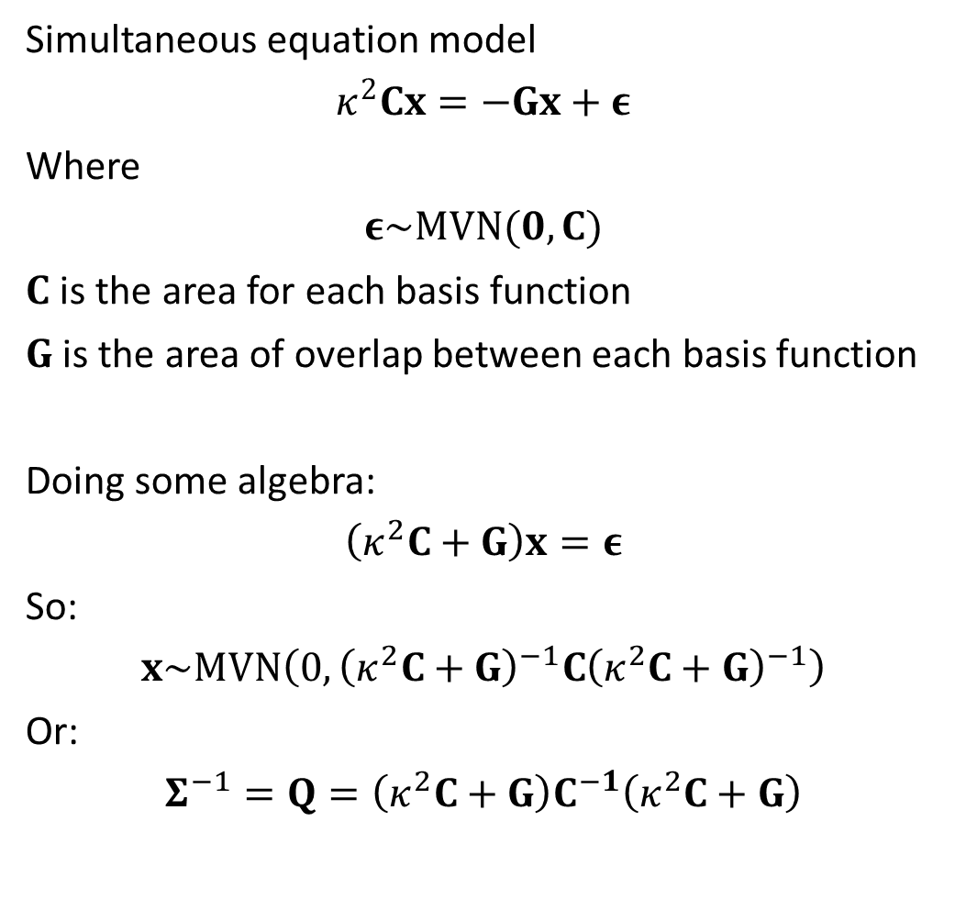
Simultaneous equation model
$$κ^{2}Cx=−Gx+ε$$
Where
$$ε\sim MVN(0,C)$$
$C$ is the area for each basis function
$G$ is the area of overlap between each basis function
Doing some algebra:
$$\left(κ^{2}C+G\right)x=ε$$
So:
$$x\sim MVN\left(0,{\left(κ^{2}C+G\right)}^{−1}C{\left(κ^{2}C+G\right)}^{−1}\right)$$
Or:
$$Σ^{−1}=Q=\left(κ^{2}C+G\right)C^{−1}\left(κ^{2}C+G\right)$$

Slide 20
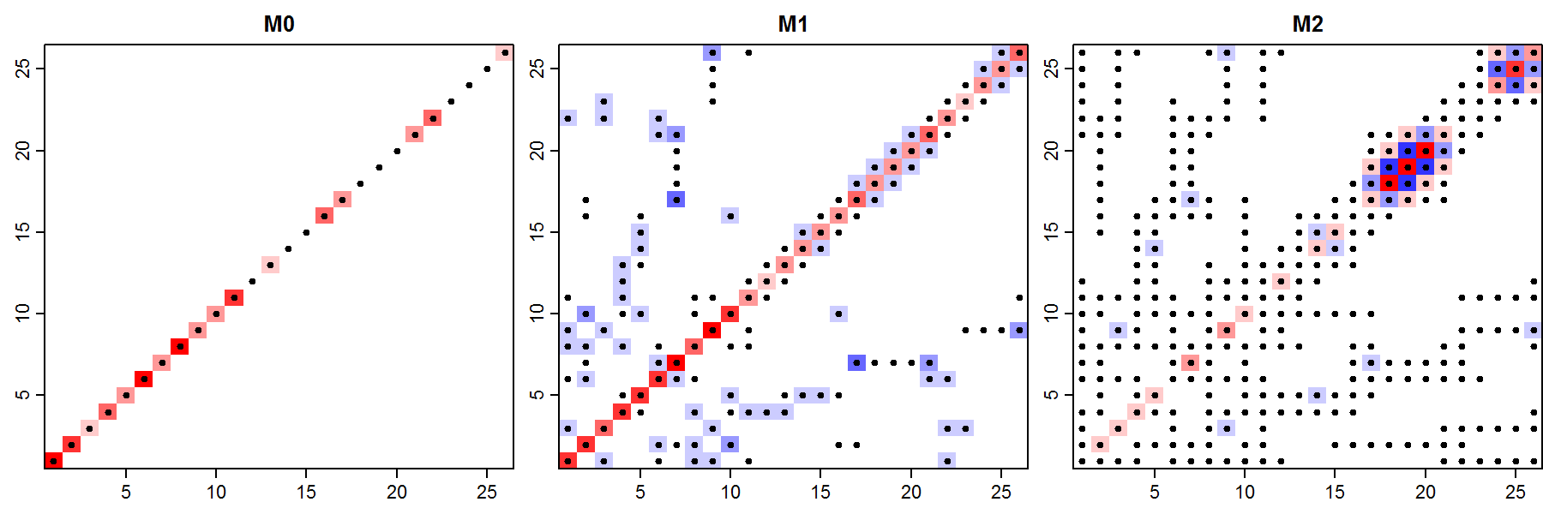

Joint distribution
$$ε\sim MVN\left(0,Σ\right)$$
Which can reduce to a linear form:
$${Σ^{−1}= κ}^{4}M_{0}+2κ^{2}M_{1}+M_{2}$$
$$M_{2}=M_{1}{M_{0}}^{−1}M_{1}$$

Slide 21

Why is the SPDE approximation good?
Faster computation when using precision matrix
$$\operatorname{Pr}\left(ε | Σ\right)∝\sqrt{det(Q)}\exp\left(−0.5ε^{T}Qε\right)$$
Can be used for a regular grid
Generalizes other simple cases

Slide 22
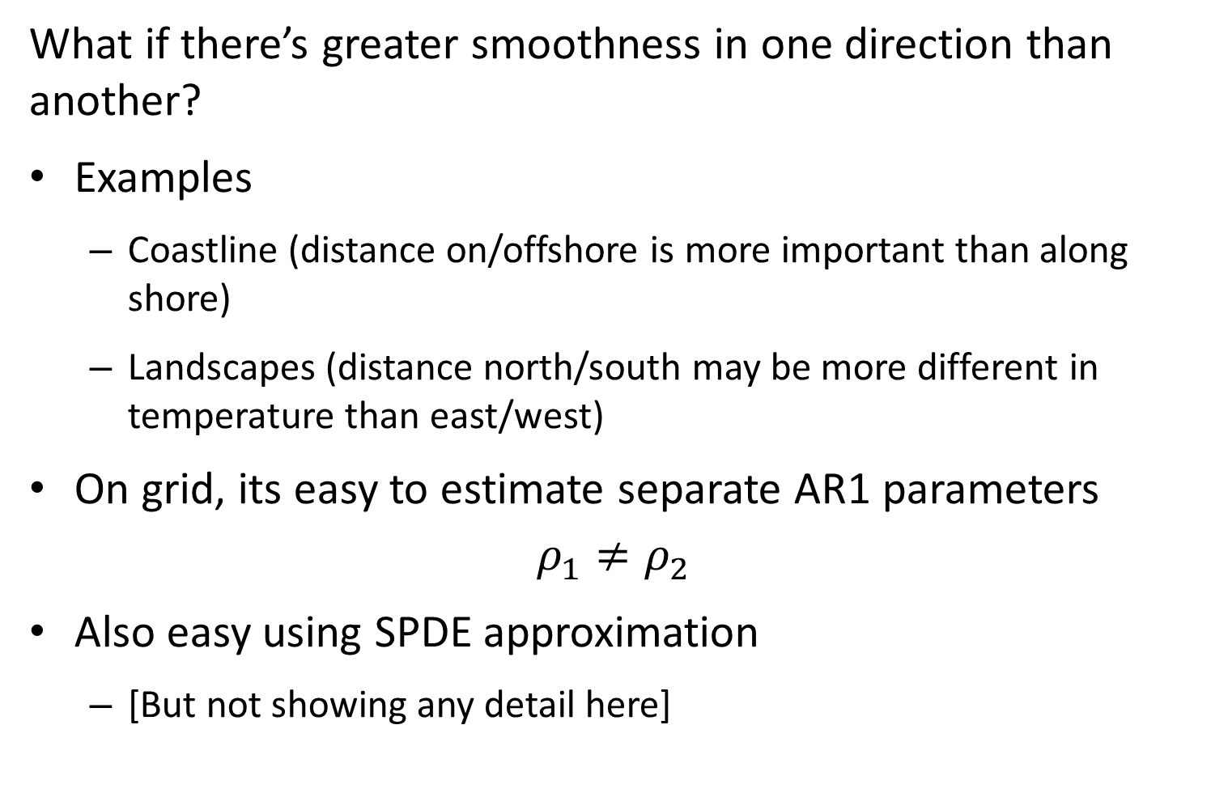
What if there’s greater smoothness in one direction than another?
Examples
Coastline (distance on/offshore is more important than along shore)
Landscapes (distance north/south may be more different in temperature than east/west)
On grid, its easy to estimate separate AR1 parameters
$$ρ_{1}≠ρ_{2}$$
Also easy using SPDE approximation
[But not showing any detail here]

Slide 23
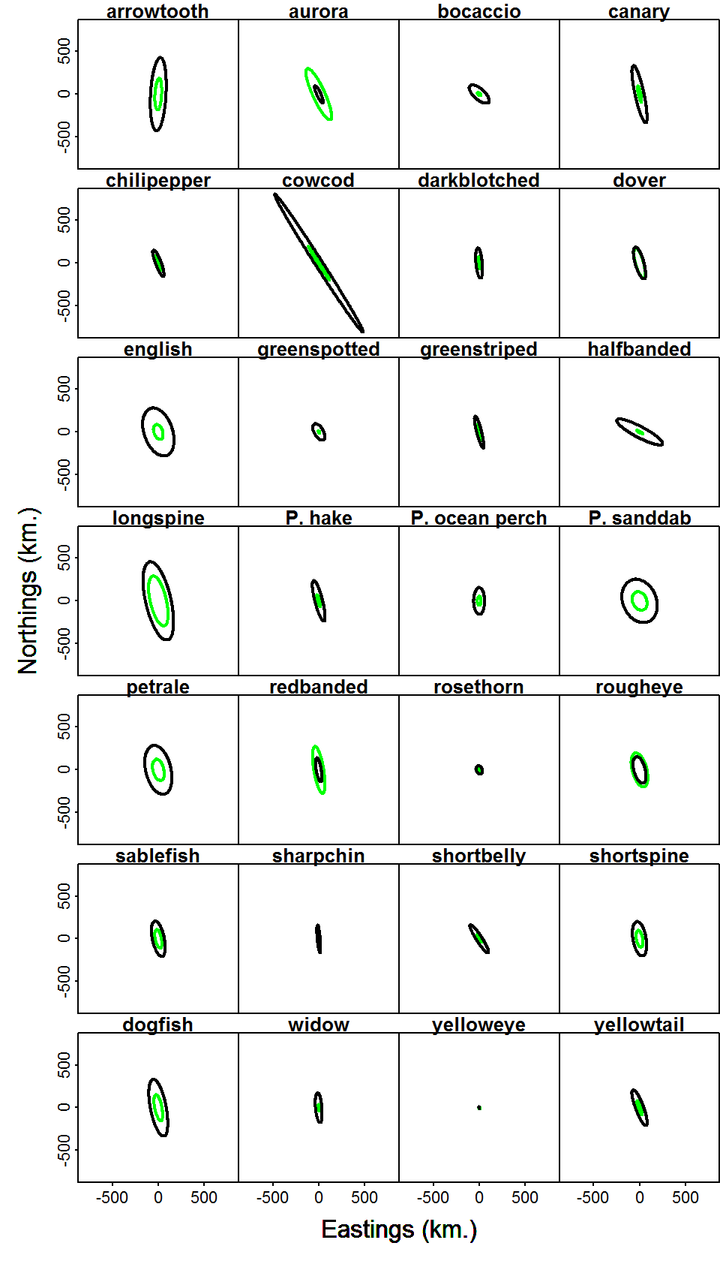
Geostatistical tool
Geometric anisotropy can be significant
Green: presence/absence; black: positive

